Slide 1

The Upper Extremity
OJORA K.A

Slide 2
Introduction: Surface Anatomy And Osteology
1. Surface anatomy
Regions of the upper limb: Shoulder| Arm| Forearm| Hand
2. Osteology of the upper limb
Clavicle| Scapula| Humerus| Radius Ulna| Carpals| Meta Carpals| Phalanges

Slide 3
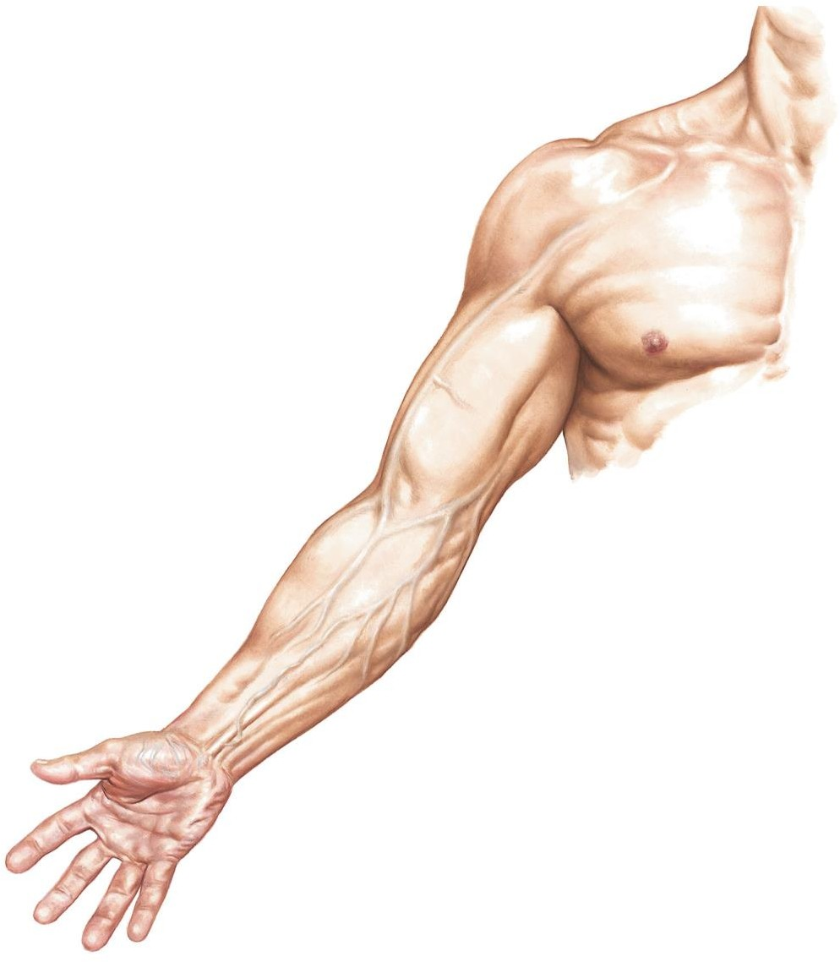
General Arrangement Of The Upper Limb
Surface anatomy
-Divided into 4 regions
Shoulder
Arm (brachium)
Forearm (Antebrachium)
Hand

Slide 4
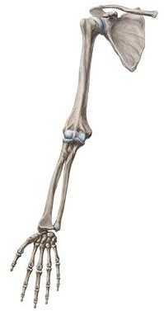
General Arrangement Of The Upper Limb
Osteology
The upper extremity includes:
Clavicle
Shoulder griddle
Scapula
Humerus (Arm)
Radius
Ulna
Carpals
Metacarpals
Phalanges
Forearm

Slide 5
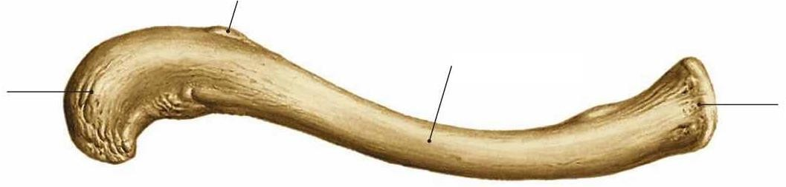
Osteology Of The Upper Limb
Clavicle – superior view
Connects sternum to scapula
Two curves
Medial (convex)
Conoid Tubercle
Sternal end
Body of clavicle
Acromial end
Lateral (concave)
Superior Surface
Smooth

Slide 6
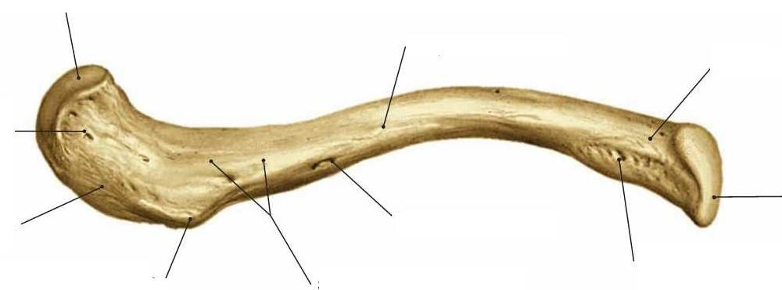
Osteology Of The Upper Limb
Clavicle – inferior view
Rough surface
Subclavian groove (attachment for subclavius)
Conoid tubercle-conoid ligament
Trapezoid line- trapezoid ligament
Acromial facet
Body of clavicle
Sternal end
Impression for-
Costaclavecular ligament
Sternal Face
Acromial end
Trapezoid Line
Nutrient foramen
Conoid tubercle
Impression for costaclavecular ligament
Subclavian groove

Slide 7
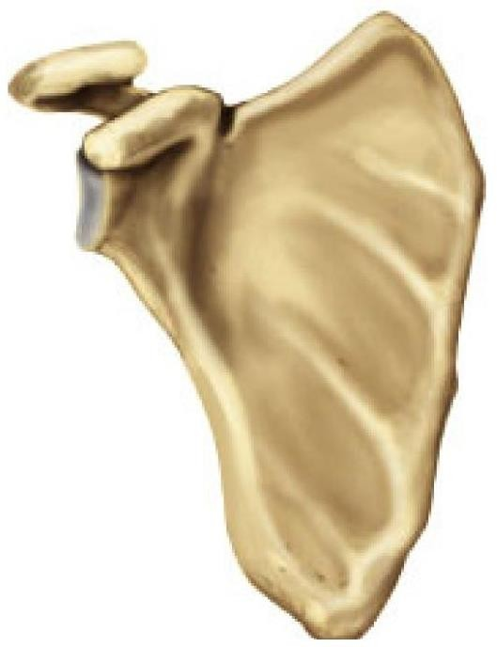
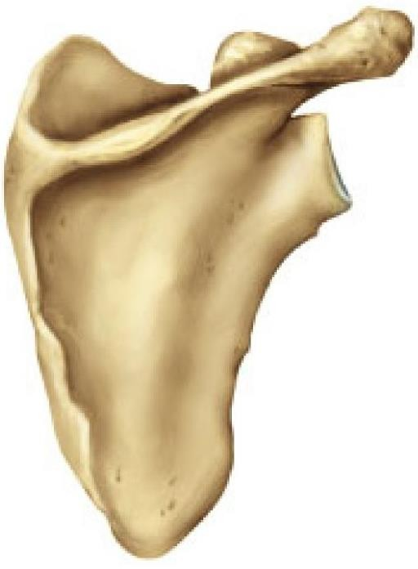
Osteology Of The Upper Limb
Scapula
Flat triangular bone
Posterior surface
Divided by spine into supraspinous and infra spinous fossae
Anterior surface
Subscapular fossa
Anterior view
Posterior view

Slide 8
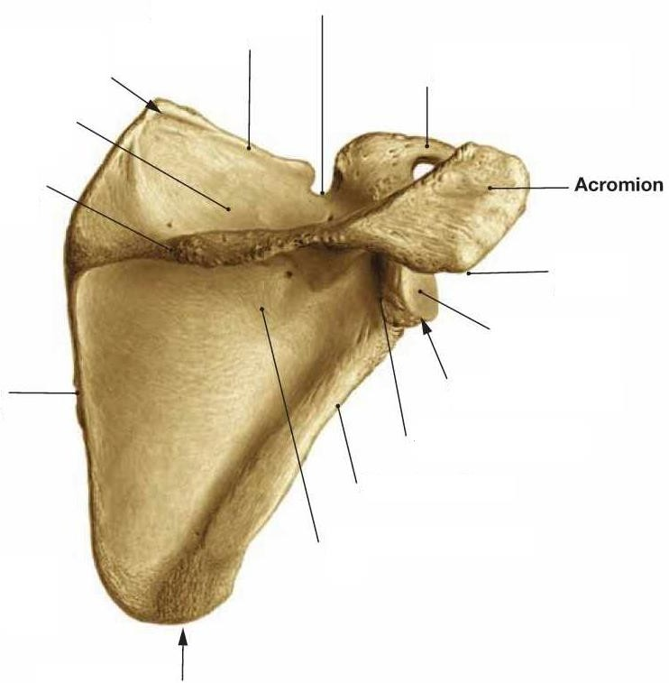
Osteology Of The Upper Limb
Scapula- posterior view
Suprascapular notch
Superior border
Borders
Lateral | Superior |Medial
Lateral Border: Head | Neck
Superior angel
Coracoid process
Supraspinous fossa Spine of scapula
Superior border: Suprascapular notch
Angels
Acromial angel
Glenoid cavity
Lateral angel Neck of the scapula
Lateral border
Superior | inferior | lateral
Medial border
Spine: enlarges laterally- Acromion
Articulates with clavicle
Head: glenoid cavity|supra- and
infra glenoid tubercles | coracoid process
Infraspinous fossa
Inferior angel

Slide 9
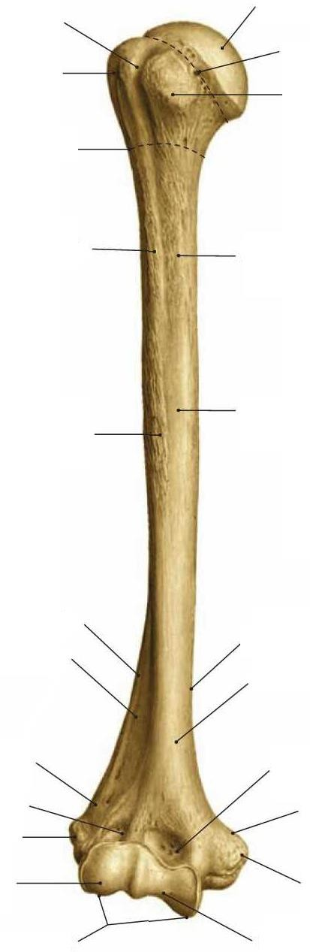
Osteology Of The Upper Limb
Humerus- anterior view
Intertubercular groove Greater tubercle
Head
Anatomical neck Lesser tubercle
Articulations
With scapula at Glenohemural joint
Head within the glenoid cavity
Tubercles
Greater tubercle
Lesser tubercle
Separated by intertubercular groove
Neck
Anatomical neck | surgical neck
Surgical neck
Crest of greater tubercle
Crest of lesser tubercle
Deltoid tuberosity
Shaft
Lateral Border Anterolateral surface
Medial Border
Anteromedial surface
Lateral supracondylar ridge
Radial fossa
Lateral epicondyle
Capitulum
Condyles
Coronoid fossa
Medial supracondylar ridge
Medial epicondyle Trochlea

Slide 10
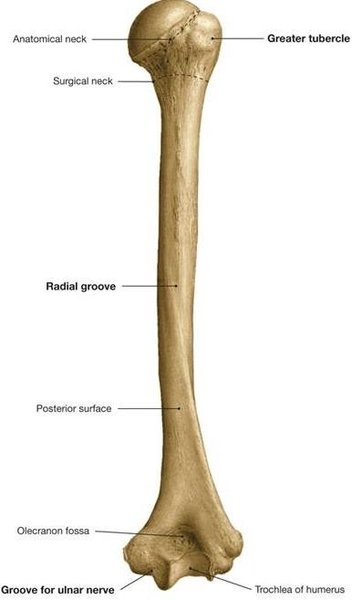
Osteology Of The Upper Limb
Humerus- posterior view
Shaft
Posteriorly- Radial groove
Inferiorly- medial and lateral supracondylar ridges
Distally- medial and lateral epicondyles
Condyle: articular surfaces
There are two : Capitulum and Trochlea
Olecranon fossa

Slide 11
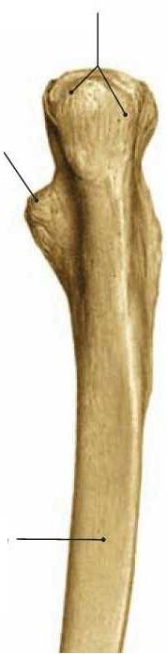
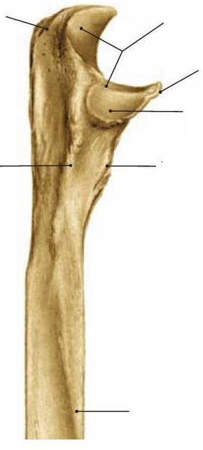

Osteology Of The Upper Limb
Ulna
Olecranon process
Trochlear notch
Olecranon process
Coronoid
process
Proximally: olecranon- | coronoid process
• = C shaped trochlear notch
Radial
Notch
Articulates with Humerus at the Trochlea
Coronoid process
Laterally: Radial notch | Supinator crest
Inferiorly: Tuberosity of ulna
Supinator crest
Ulnar tuberosity
Body
Interosseous border
Posterior view
Lateral view

Slide 12
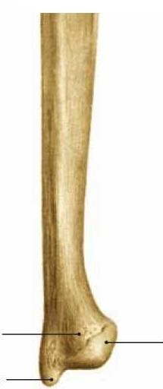
Osteology Of The Upper Limb
Ulna
Shaft
Sharp interosseous border
Distally
Ulnar head | styloid process
Does not articulate directly with the carpels.
Head of Ulna
Articular
circumference
Styloid process
Lateral view

Slide 13
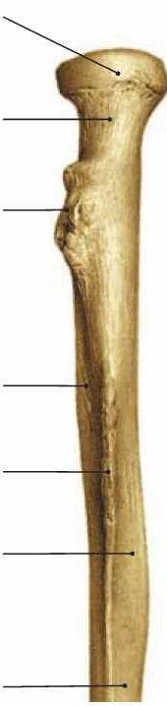
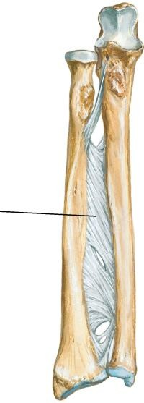
Osteology Of The Upper Limb
Radius- Proximal half
Proximally: Head | Neck | radial tuberosity
Head: Articulates with the capitulum of the humerus And the radial notch of the ulna
Radial tuberosity: attachment site for the tendon of Bicep brachii
Shaft
Sharp interosseous border
Head of radius
Neck
Radial tuberosity
Anterior surface
Interosseous border
Widens distally
Shaft (Body)
Interosseous membrane
Posterior surface
Medial view

Slide 14

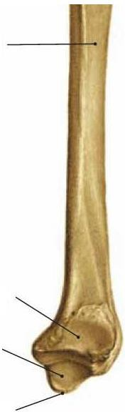
Osteology Of The Upper Limb
Radius- distal half
Medial view
Distally
Medially: Ulnar notch
Articulates with the head of the ulna
Laterally: The radial styloid notch
Dorsal tubercle
shaft
Important as pully for the extensor muscle of thumb
Ulnar notch
Carpal articular surface Radial styloid process

Slide 15
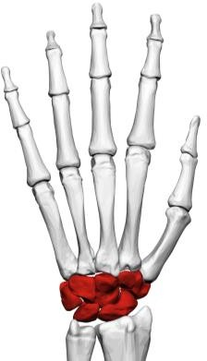
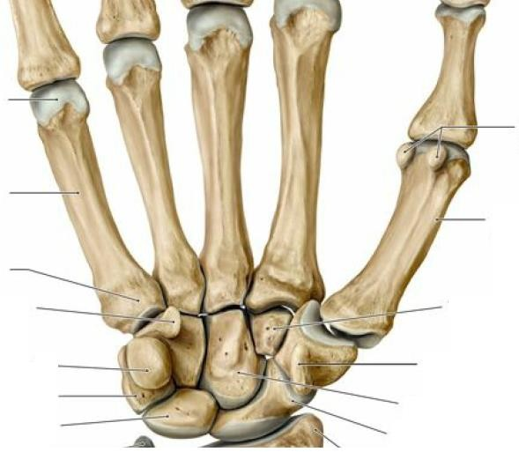
Osteology Of The Upper Limb
Hand
Wrist (carpus) has 8 bones
Two rows of carpal bones
Provides flexibility
Proximal row: Scaphoid | Lunate Triquetrum |Pisiform
Distal row: Trapezium | Trapezoid
Capitate | Hamate
Hamate
Trapezoid
Pisiform Triquetrum
Lunate
Trapezium Capitate
Scaphoid
Anterior view

Slide 16
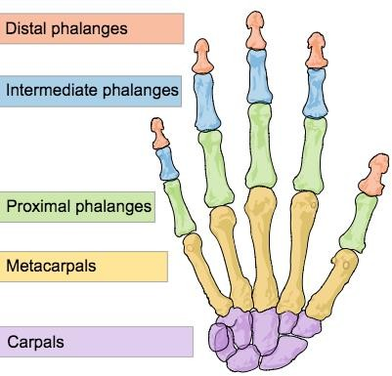
Osteology Of The Upper Limb
Hand- An easy way to memorize the carpal bones
She Looks Too Pretty Try To Catch Her
Scaphoid
Lunate
Triquetrum
Pisiform
Trapezium
Trapezoid
Capitate
Hamate

Slide 17
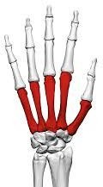
Osteology Of The Upper Limb
Hand- Meta Carpals
Palm(metacarpus) is made up of 5 meta carpal bones, each bone has:
Base
Which articulates with the distal row of carpals
Shaft
Head
Articulates with the proximal phalanges

Slide 18
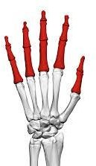
Osteology Of The Upper Limb
Hand - Phalanges
3 Phalanges on each digit: Proximal | Intermediate | Distal
Except digit 1(thumb), which contains only two
Proximal and distal
Each phalanx have:
Base
Articulates with the metacarpal
Shaft
Head

Slide 19
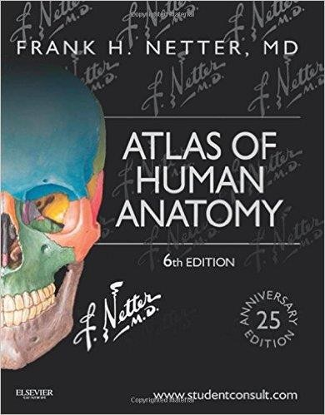
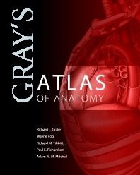
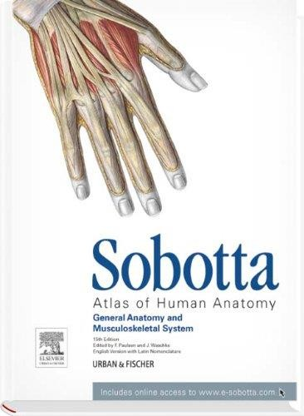
Credits
The illustrations used in this presentation are taken from:

